Slide 1
Pandas
CS3300 Data Science

Slide 2
Readings
Chapters 2 and 3 of the Python Data Science Handbook

Slide 3
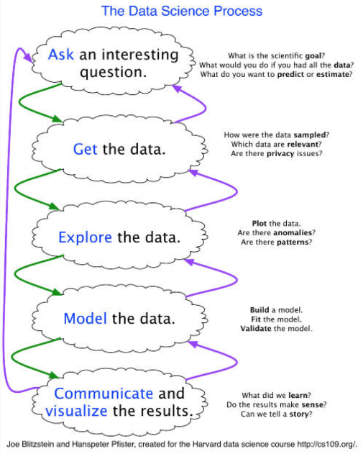
Data Science Process

Slide 4
What is Pandas?
Library for manipulating tables of data
Primarily used for cleaning and restructuring data in preparation for plotting or modeling
3 primary data structures
Series – 1D, columns of data
DataFrames – 2D, tables of data
Panel – 3D, cube of data (rarely used, deprecated and going to be removed)
Columnar
Most operations are designed to operate on columns of data, not individual elements or rows

Slide 5
Pandas vs Numpy
Numpy
Pandas
Any dimension
Indexing by position (e.g., row or column)
Usually a single type (e.g., int, float)
Limited to 1 (Series) or 2 (DataFrame) dimensions
Indexing primarily by column names
Each column has a its own type

Slide 6
Pandas and SQL
A DataFrame is similar to a table in a SQL database
SQL also operates on columns
Many Pandas operations have analogs in SQL:
Head – select * from <table> limit 10;
Selecting columns – select column1, column2, … from <table>;
Filtering rows – where column1 > 5;
Grouping rows – select max(…), column2 … group by column2;
Joining tables – select … from table1 join table2 on table1.column1 = table2.column1;
Pandas DataFrames have an index – this is normally the implicit numerical index

Slide 7
Caveats
Pandas offers multiple ways to do things. Some ways are newer and have learned from the mistakes of the old ways. This can be confusing and frustrating
The pandas documentation is complex and not well organized
It can be difficult to predict when a copy is made versus a view is created – this makes optimization challenging

Slide 8
Creating DataFrames
Read from a CSV file: df = pd.read_csv(filename)
From existing lists, Numpy, arrays, or series: df = pd.DataFrame( { "column1" : [0.0, 1.0, 2.0], "column2" : np_array, "column3" : series } )

Slide 9
Investigating DataFrames
df.head()
df.dtypes
df.shape

Slide 10
Indexing / Selecting Columns
Pandas has multiple ways to index. The slice operator works on columns: df["column name"] – get a single column df[["column1", "column2", "column3"]] – get multiple columns

Slide 11
Indexing
You can index by position (numerical index). This follows the Numpy pattern of row, then column: df.iloc[5] – get a single row df.iloc[:, :3] – get first 3 columns and all rows of the df df.iloc[1:100] – get the second to 100th rows

Slide 12
Creating a New Column
The simplest way to create a new column: df["new column name"] = <list, 1D numpy array, Series>
The assign method is useful since its returns a new DataFrame and can be used with method chaining: new_df = df.assign(<new_column_name> = <list, 1D numpy array, Series>)

Slide 13
Modifying a Column
Convert data types – may need to specify function for parsing / conversion
Cleaning data
Extracting fields from complex types
e.g., hour, month, etc. from date times

Slide 14
Modifying a Column
Get the Series for the column of interest column = df["column name"]
Use the map() method to apply a function to each element in the Series an return a new Series converted = column.map(lambda s: s + 1)
Then update the df, either by adding a new column or overwriting the original column df["column name"] = converted

Slide 15
Dropping a Column
I prefer to use the drop() method because it returns a DataFrame object so it works with chaining: new_df = df.drop(columns=["column name"])
You might see this, too: del df["column_name"] I like this less because it updates the DataFrame in place.

Slide 16

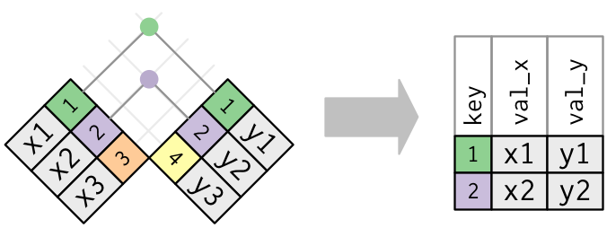
Inner Joins

Slide 17
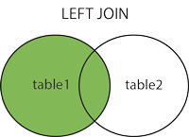
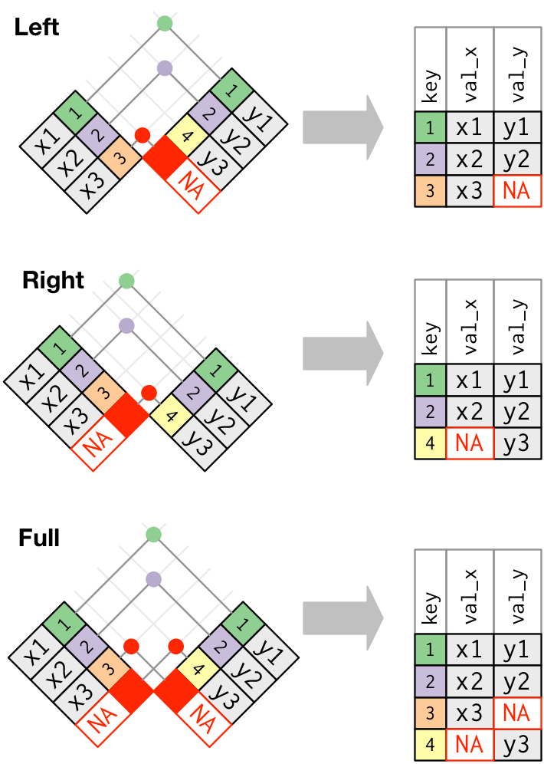
Left Outer Join

Slide 18
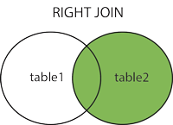
Right Outer Join

Slide 19
Full Outer Join

Slide 20
Pandas Join
joined_df = df1.merge(df2, on = "column", how = "inner") joined_df = df1.merge(df2, left_on = "column1", right_on = "column2", how = "outer")

Slide 21
Group By and Aggregations
Group by groups columns by a set of keys and aggregates the values in the remaining columns
Two types of columns participate in group by:
Columns that are they keys – the keys have to have the exact same values for rows to be matched up
Aggregated columns – we apply count, min, max, sum, or a similar function to reduce multiple values to a single value

Slide 22
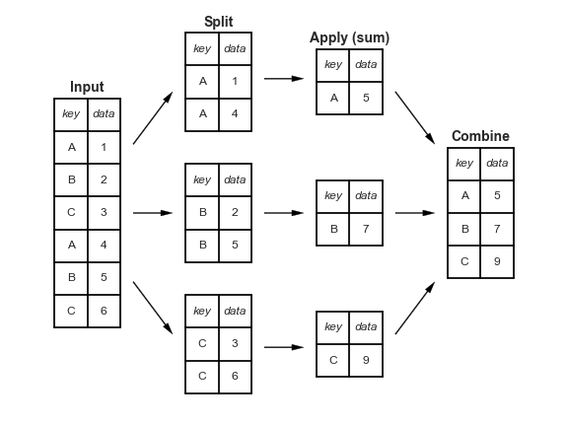
Group By and Aggregations

Slide 23
Group By and Aggregations
My preferred recipe:
Select the columns you want to use: df_to_group = df[["column1", "column2", "column3"]]
Perform the group by: grouped_df = df_to_group.groupby(by = ["column1", "column2"], as_index = False) .min()

